Slide 1
Startup Success
Will a Company Succeed?
Presented By: Walker McFarlan
Notes:
Hi! My name is Walker McFarlan and I have done an analysis on startups in the United States with the goal of predictive modeling.

Slide 2
Problem
Solution
Investment Firms can lose a substantial sums of money due to poor investment strategy
Over 32 billion dollars was lost on 2,897 bad investments on my dataset
Investing is expensive
The median investment per startup is 1,800,000$
Feature Analysis
What indicators can be found to predict success?
Predictive Modeling
Build and train a machine learning model to create focused predictions
Notes:
The primary problem is investment firms need to make smart investments. On my dataset, over 32 billion dollars was lost. The other problem is investing is expensive. The median investment per company was 1,800,000$.
The solution to these problems is smart feature analysis and predictive modeling. Why are companies succeeding and can we predict their success.

Slide 3
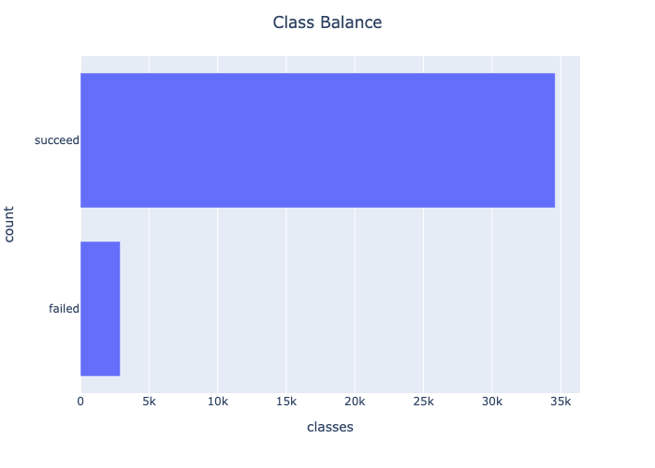
The Data
Primary Data was collected from Data.World
Over 37,000 different startups in United States
2,897 of those 37,000 have failed
Additional Data:
GDP per state collected from Hub.Arcgis
City population statistics SimpleMaps
Education Statistics Data.World
Notes:
My data consists of over 37 thousand different startups within the United States. A little under 3,000 of these companies have failed. GDP, population and education statistics were pulled in to add more features.

Slide 4
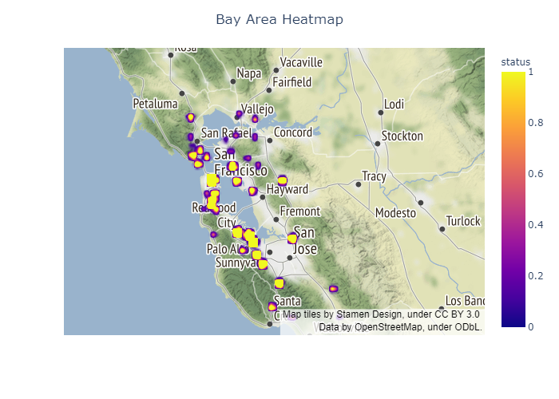
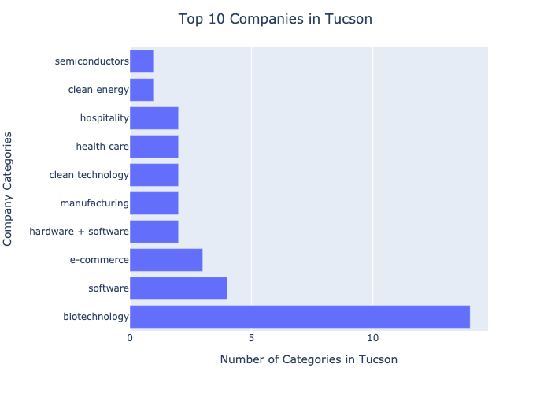
Clustering Matters
Notes:
Doing EDA, the primary discovery was the clustering of success. On the left, we have a heatmap of the bay area. It can be seen that there are clusters that create more success and clusters of failed companies. This hints at the importance of location.
On the right, here is a distribution of companies in Tucson. Tucson was selected as it is the number one most successful region in my dataset. Interestingly, a cluster of biotechnology can be seen. This finding suggests the importance of company clustering to create success.

Slide 5
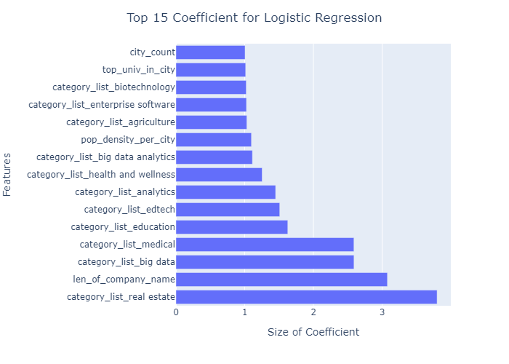
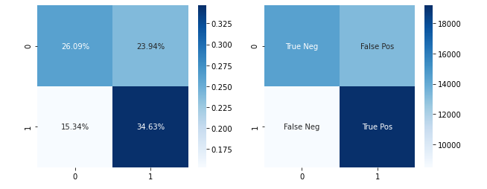
Predicting with Logistic Regression
Baseline recall: 0.5%
Optimized model recall: 0.73%
Notes:
Logistic Regression was initially selected as the predictive model due to the interpretability of the coefficients. After optimizing the hyperparameters, a recall score of 73% was achieved. Upon exploring the coefficients, it can be seen that certain companies are more likely to succeed than others. Furthermore, if we look at population density and city count, these tell an interesting story.
After conducting EDA, companies are more likely to succeed if there are more startups around them. Companies are also more likely to succeed if they are in higher population dense cities.

Slide 6
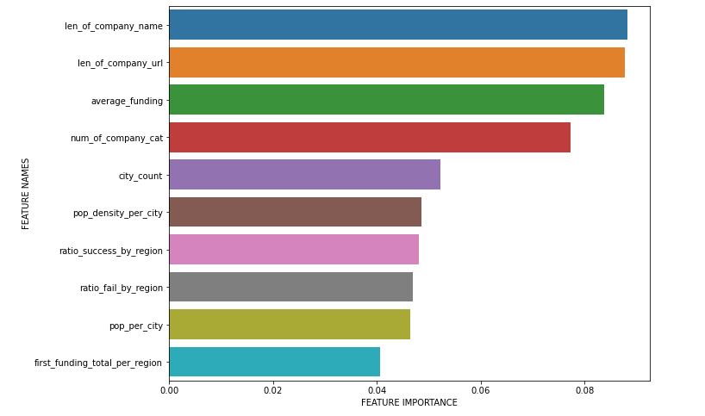
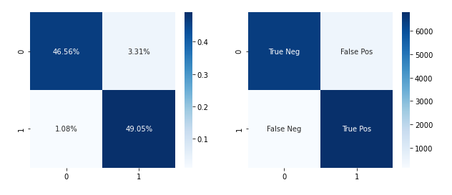
Predicting with Random Forest
Recall Score: 0.98%
Notes:
Random Forest was selected as the more robust predictive model with the trade off of losing some interpretability. This model was tuned for recall and provided a recall score of over 98%. This model performs better on both recall and accuracy compared to logistic regression, however interpreting the feature importance must be taken with a grain of salt as encoded features are under-represented. However, Random Forest does also seems to suggest the importance of location to a company's success.

Slide 7
Limitations
Future work
Business is an ecosystem
Many factors to success and failure, not captured in currently available feature subset
Not enough granular data
Build specific models to specific cities
More features
Discovering more complex relationships
Notes:
The primary limitation of this study is the complexity of business ecosystems and success. My features were not granular and were incapable to capturing certain trends. This leads to future work. Finding more features and geolocational data can lead to better modeling and better insight. What I have discovered in my modeling and EDA is that location matters, the next step should be to extract more features of locations to find more precise relationships.

Slide 8
Questions?

